Slide 1


Stock Market Forecasting
The Stock Forecasting Web App is a full-stack web application designed to predict stock market trends using advanced machine learning models. Built with Flask as the backend framework, it integrates multiple ML algorithms such as ARIMA and Random Forest to analyze historical stock data and provide accurate predictions. The app is structured with a modular folder hierarchy that separates models, routes, templates, and utilities, making it easy to maintain and extend. Users can interact with the application through a responsive and interactive dashboard, which visualizes stock trends and predictions using dynamic charts. The platform also incorporates additional features to enhance user experience and engagement. A chatbot, powered by AI, allows users to query stock-related information and get real-time insights. The app includes user authentication for secure access and offers features like trending stock tracking, prediction summaries, and data visualization tools. By combining machine learning, data analytics, and a user-friendly interface, this web application provides both investors and developers with a comprehensive solution for monitoring and forecasting stock market behavior

Slide 2
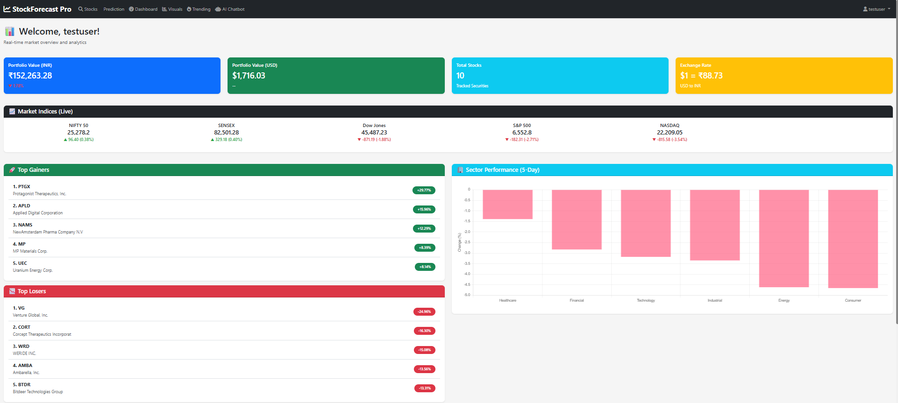
Project Overview
Revolutionizing Stock Forecasting
This web application leverages advanced machine learning techniques to provide accurate stock predictions, enabling investors to make informed and strategic decisions based on real-time data and analytics.

Slide 3
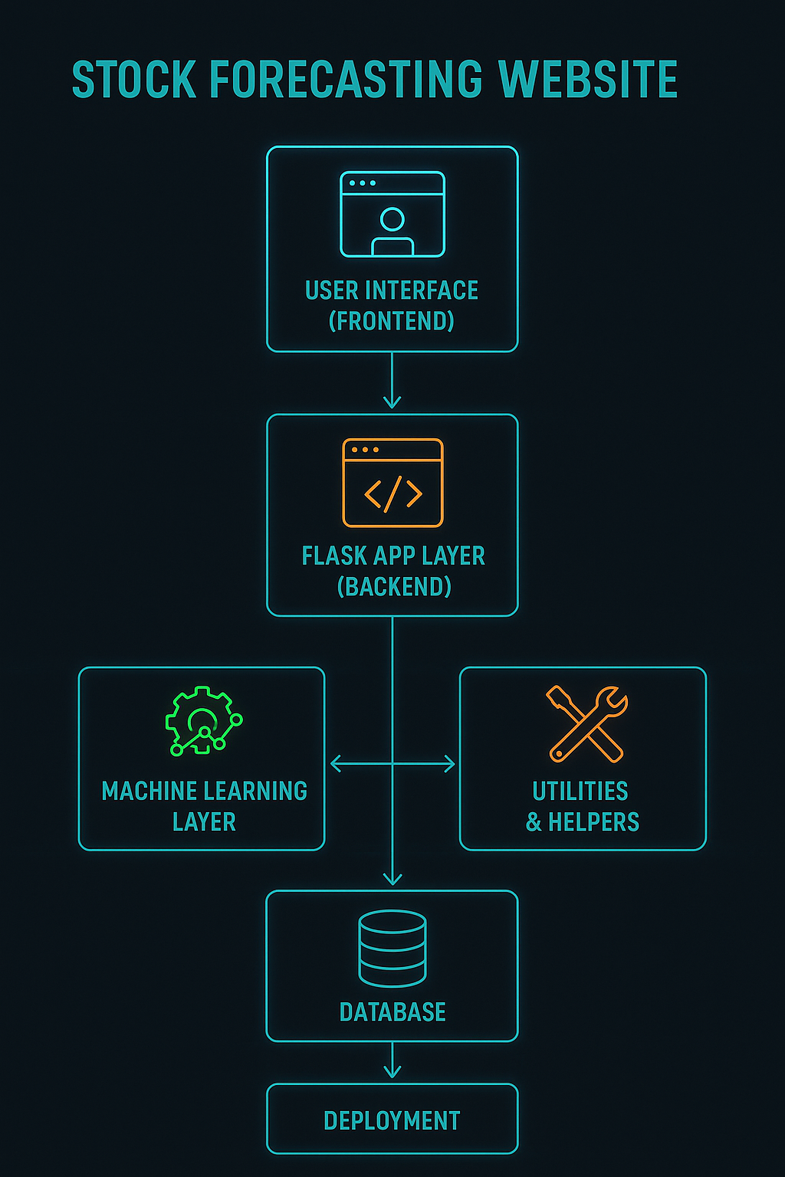
Architecture & Workflow
Streamlined Data Flow
The application utilizes a modular architecture to facilitate seamless data flow, integrating the Flask backend, machine learning models, and web interface for efficient processing and user interaction.

Slide 4
Machine Learning Models
Exploring Advanced Forecasting Techniques
ARIMA Model
Prophet Model
Random Forest
The ARIMA model utilizes time series analysis to predict future stock prices based on past values. It effectively captures trends and seasonal patterns in financial data.
Developed by Facebook, the Prophet model leverages additive regression to forecast time series data. It accommodates seasonal effects and is robust to missing data, making it widely applicable.
The Random Forest model employs ensemble learning to enhance prediction accuracy. By aggregating multiple decision trees, it minimizes overfitting and improves performance on complex stock market data.

Slide 5
Web App Features
Predictions
Our application utilizes advanced algorithms to provide accurate stock forecasts, enabling users to make informed investment decisions easily.
Key Functionalities of Our Stock Forecasting Platform
Dashboards
Interactive dashboards present real-time data visualizations, allowing users to track market trends and analyze stock performance seamlessly.
Visualizations
Comprehensive visualizations enhance the user experience, offering insights into market dynamics and facilitating deeper analysis of stock movements.

Slide 6

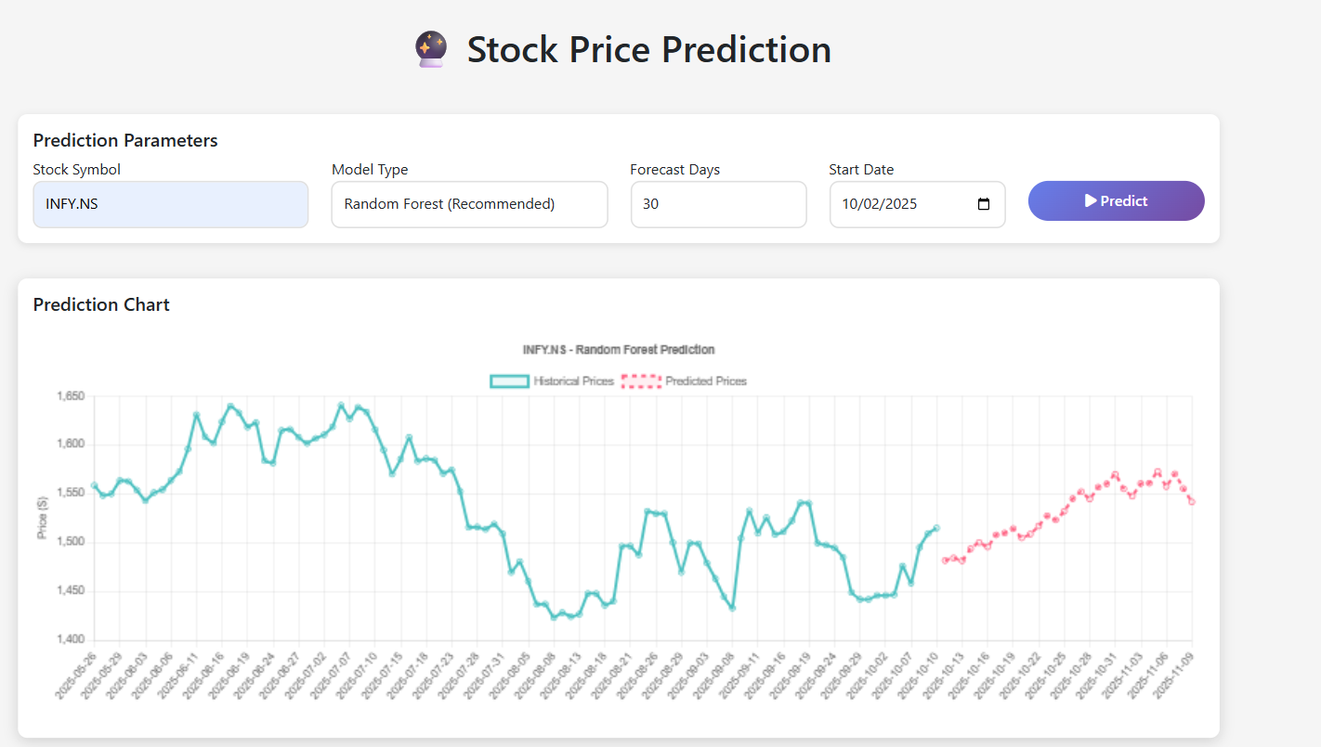
Results & Insights
Empowering Decisions with Data Analysis
Our application delivers accurate forecasts and actionable insights, enabling users to make informed financial decisions based on comprehensive data analysis and visualizations of stock trends and market movements.

Slide 7
THANK YOU !

